Slide 1
EECS 252 Graduate Computer Architecture
Lec 1 - Introduction
John Kubiatowicz
Electrical Engineering and Computer Sciences
University of California, Berkeley
http://www.eecs.berkeley.edu/~kubitron/cs252
http://www-inst.eecs.berkeley.edu/~cs252
Notes:
CS252 S05

Slide 2
What is “Computer Architecture”?
Applications
App photo
Operating
System
Compiler
Firmware
Instruction Set
Architecture
Instr. Set Proc.
I/O system
Datapath & Control
Digital Design
Circuit Design
Layout & fab
Semiconductor Materials
Die photo
Coordination of many levels of abstraction
Under a rapidly changing set of forces
Design, Measurement, and Evaluation
CS252-S07, Lecture 01
Notes:
CS252 S05

Slide 3
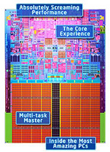
Technology constantly on the move!
All major manufacturers have announced and/or are shipping multi-core processor chips
Intel talking about 80 cores
in not-to-distance future
3-dimensional chip technology
  Sandwiches of silicon
  “Through-Vias” for communication
Number of transistors/dice keeps increasing
  Intel Core 2: 65nm, 291 Million transistors!
  Intel Pentium D 900: 65nm, 376 Million Transistors!
Intel Core Duo
CS252-S07, Lecture 01

Slide 4
Dramatic Technology Advance
Prehistory: Generations
  1st Tubes
  2nd Transistors
  3rd Integrated Circuits
  4th VLSI….
  5th Nanotubes? Optical? Quantum?
Discrete advances in each generation
  Faster, smaller, more reliable, easier to utilize
Modern computing: Moore’s Law
  Continuous advance, fairly homogeneous technology
CS252-S07, Lecture 01

Slide 5
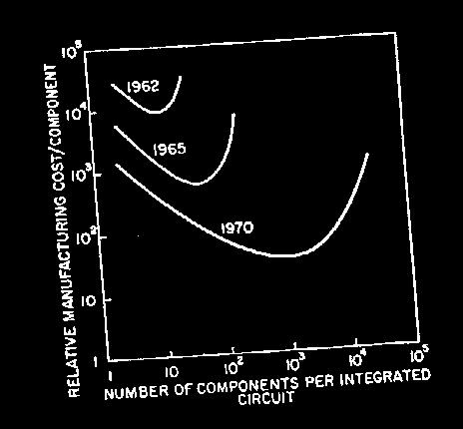
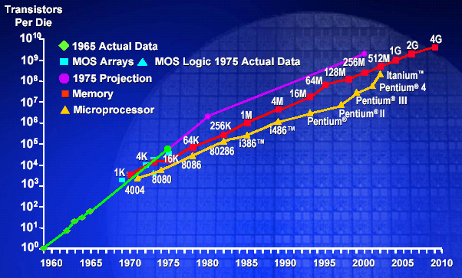
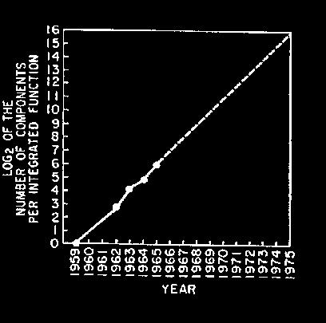
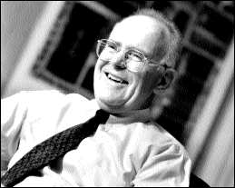
Moore’s Law
“Cramming More Components onto Integrated Circuits”
  Gordon Moore, Electronics, 1965
# on transistors on cost-effective integrated circuit double every 18 months
CS252-S07, Lecture 01

Slide 6
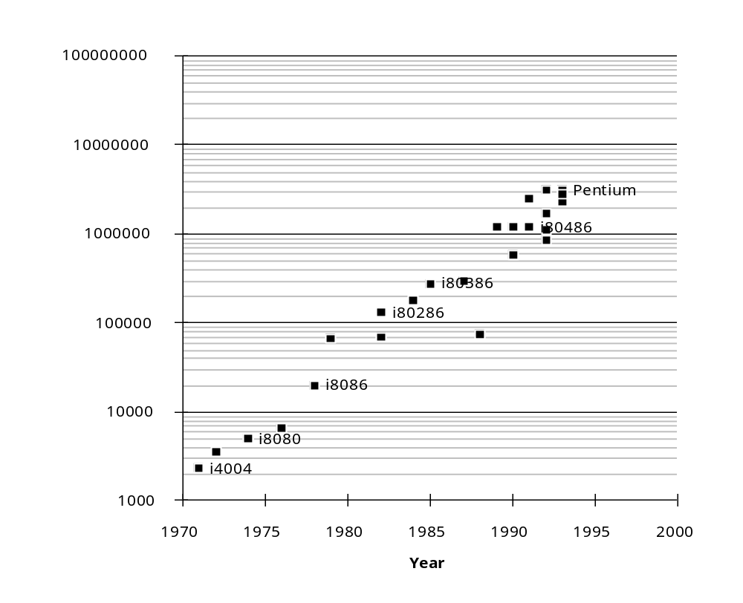
Joy’s Law: Exponential Performance Improvement until…2002???
End of Joy’s Law???
CS252-S07, Lecture 01

Slide 7
Computer Architecture’s
Changing Definition
1950s to 1960s: Computer Architecture Course: Computer Arithmetic
1970s to mid 1980s: Computer Architecture Course: Instruction Set Design, especially ISA appropriate for compilers
1990s: Computer Architecture Course:
Design of CPU, memory system, I/O system, Multiprocessors, Networks
2000s: Multi-core design, on-chip networking, parallel programming paradigms, power reduction
2010s: Computer Architecture Course: Self adapting systems? Self organizing structures?
DNA Systems/Quantum Computing?
CS252-S07, Lecture 01

Slide 8
The Instruction Set: a Critical Interface
software
instruction set
hardware
Properties of a good abstraction
  Lasts through many generations (portability)
  Used in many different ways (generality)
  Provides convenient functionality to higher levels
  Permits an efficient implementation at lower levels
CS252-S07, Lecture 01
Notes:
CS252 S05

Slide 9
Instruction Set Architecture
... the attributes of a [computing] system as seen by the programmer, i.e. the conceptual structure and functional behavior, as distinct from the organization of the data flows and controls the logic design, and the physical implementation. – Amdahl, Blaaw, and Brooks, 1964
SOFTWARE
-- Organization of Programmable
Storage
-- Data Types & Data Structures:
Encodings & Representations
-- Instruction Formats
-- Instruction (or Operation Code) Set
-- Modes of Addressing and Accessing Data Items and Instructions
-- Exceptional Conditions
CS252-S07, Lecture 01
Notes:
CS252 S05

Slide 10
Computer Architecture is an
Integrated Approach
What really matters is the functioning of the complete system
  hardware, runtime system, compiler, operating system, and application
  In networking, this is called the “End to End argument”
Computer architecture is not just about transistors, individual instructions, or particular implementations
  E.g., Original RISC projects replaced complex instructions with a compiler + simple instructions
It is very important to think across all hardware/software boundaries
  New technology ⇒ New Capabilities ⇒ New Architectures ⇒
  New Tradeoffs
  Delicate balance between backward compatibility and efficiency
CS252-S07, Lecture 01

Slide 11
Elements of an ISA
Set of machine-recognized data types
  bytes, words, integers, floating point, strings, . . .
Operations performed on those data types
  Add, sub, mul, div, xor, move, ….
Programmable storage
  regs, PC, memory
Methods of identifying and obtaining data referenced by instructions (addressing modes)
  Literal, reg., absolute, relative, reg + offset, …
Format (encoding) of the instructions
  Op code, operand fields, …
Current Logical State
of the Machine
Next Logical State
of the Machine
CS252-S07, Lecture 01

Slide 12
Example: MIPS R3000
r0
r1
°
°
°
r31
0
Programmable storage
2^32 x bytes
31 x 32-bit GPRs (R0=0)
32 x 32-bit FP regs (paired DP)
HI, LO, PC
Data types ?
Format ?
Addressing Modes?
PC
lo
hi
  Arithmetic logical
  Add, AddU, Sub, SubU, And, Or, Xor, Nor, SLT, SLTU,
  AddI, AddIU, SLTI, SLTIU, AndI, OrI, XorI, LUI
  SLL, SRL, SRA, SLLV, SRLV, SRAV
  Memory Access
  LB, LBU, LH, LHU, LW, LWL,LWR
  SB, SH, SW, SWL, SWR
  Control
  J, JAL, JR, JALR
  BEq, BNE, BLEZ,BGTZ,BLTZ,BGEZ,BLTZAL,BGEZAL
32-bit instructions on word boundary
CS252-S07, Lecture 01

Slide 13
ISA vs. Computer Architecture
Old definition of computer architecture
= instruction set design
  Other aspects of computer design called implementation
  Insinuates implementation is uninteresting or less challenging
Our view is computer architecture >> ISA
Architect’s job much more than instruction set design; technical hurdles today more challenging than those in instruction set design
Since instruction set design not where action is, some conclude computer architecture (using old definition) is not where action is
  We disagree on conclusion
  Agree that ISA not where action is (ISA in CA:AQA 4/e appendix)
CS252-S07, Lecture 01

Slide 14
Computer Architecture Topics
Input/Output and Storage
Disks, WORM, Tape
RAID
Emerging Technologies
Interleaving
Bus protocols
DRAM
Memory
Hierarchy
Coherence,
Bandwidth,
Latency
L2 Cache
Network
Communication
Other Processors
L1 Cache
Addressing,
Protection,
Exception Handling
VLSI
Instruction Set Architecture
Pipelining, Hazard Resolution,
Superscalar, Reordering,
Prediction, Speculation,
Vector, Dynamic Compilation
Pipelining and Instruction
Level Parallelism
CS252-S07, Lecture 01

Slide 15
Computer Architecture Topics
Shared Memory,
Message Passing,
Data Parallelism
P
M
P
M
P
M
P
M
° ° °
S
Interconnection Network
Network Interfaces
Processor-Memory-Switch
Topologies,
Routing,
Bandwidth,
Latency,
Reliability
Multiprocessors
Networks and Interconnections
CS252-S07, Lecture 01
Notes:
CS252 S05

Slide 16
CS 252 Course Focus
Understanding the design techniques, machine structures, technology factors, evaluation methods that will determine the form of computers in 21st Century
Technology
Parallelism
Programming
Languages
Applications
Interface Design
(ISA)
Computer Architecture:
• Instruction Set Design
• Organization
• Hardware/Software Boundary
Compilers
Operating
Measurement & Evaluation
Systems
History
CS252-S07, Lecture 01

Slide 17

Tentative Topics Coverage
Textbook: Hennessy and Patterson, Computer Architecture: A Quantitative Approach, 4th Ed., 2006
Research Papers -- Handed out in class
1.5 weeks Review: Fundamentals of Computer Architecture, Instruction Set Architecture, Pipelining
2.5 weeks: Pipelining, Interrupts, and Instructional Level Parallelism, Vector Processors
1 week: Dynamic Compilation. Data Speculation (papers). Complexity, design via genetic algorithms
1 week: Memory Hierarchy
1.5 weeks: Fault Tolerance, Input/Output and Storage
1.5 weeks: Networks and Interconnection Technology
2 weeks: Multiprocessors
1 week: Quantum Computing, DNA Computing
CS252-S07, Lecture 01

Slide 18
CS252: Information
Instructor:Prof John D. Kubiatowicz
Office: 673 Soda Hall, 643-6817 kubitron@cs
Office Hours: Mon 1:00-2:30 or by appt.
T. A: TBA
Class: Mon/Wed, 2:30-4:00pm, 310 Soda Hall
Text: Computer Architecture: A Quantitative Approach, Third Edition (2002)
Web page: http://www.cs/~kubitron/cs252/
Lectures available online <11:30AM day of lecture
Newsgroup: ucb.class.cs252
Email: cs252@kubi.cs.berkeley.edu
CS252-S07, Lecture 01
Notes:
CS252 S05
This slide is for the 3-min class administrative matters.
Make sure we update Handout #1 so it is consistent with this slide.

Slide 19
Lecture style
1-Minute Review
20-Minute Lecture/Discussion
5- Minute Administrative Matters
25-Minute Lecture/Discussion
5-Minute Break (water, stretch)
25-Minute Lecture/Discussion
Instructor will come to class early & stay after to answer questions
Attention
20 min.
Break
“In Conclusion, ...”
Time
CS252-S07, Lecture 01

Slide 20
Grading
15% Homeworks (work in pairs) & paper summaries
35% Examinations (2 Midterms)
35% Research Project (work in pairs)
  Transition from undergrad to grad student
  Berkeley wants you to succeed, but you need to show initiative
  pick topic
  meet 3 times with faculty/TA to see progress
  give oral presentation
  give poster session
  written report like conference paper
  3 weeks work full time for 2 people
  Opportunity to do “research in the small” to help make transition from good student to research colleague
15% Class Participation
CS252-S07, Lecture 01

Slide 21
Quizes
Reduce the pressure of taking quizes
  Only 2 Graded Quizes:
  Tentative: Wed March 14th and Wed May 2nd
  Our goal: test knowledge vs. speed writing
  3 hrs to take 1.5-hr test (5:30-8:30 PM, TBA location)
  Both mid-term quizes can bring summary sheet
    Transfer ideas from book to paper
  Last chance Q&A: during class time day of exam
Students/Staff meet over free pizza/drinks at La Vals:
Wed March 14th (8:30 PM) and Wed May 2nd (8:30 PM)
CS252-S07, Lecture 01
Notes:
CS252 S05
This is the 1st slide of the “Course Structure and Course Philosophy” section of the lecture.
Need to emphasis that for exams, our goal is the test your knowledge. It is not our goal to test how well your perform under time pressure.

Slide 22
Research Paper Reading
As graduate students, you are now researchers.
Most information of importance to you will be in research papers.
Ability to rapidly scan and understand research papers is key to your success.
So: you will read lots of papers in this course!
  Quick 1 paragraph summaries will be due in class
  Important supplement to book.
  Will discuss papers in class
Papers will be scanned and on web page.
CS252-S07, Lecture 01

Slide 23
More Course Info
Everything is on the course Web page:
www.cs.berkeley.edu/~kubitron/cs252
Notes:
  Not sure what the state of textbooks at Student Center.
  The course Web page includes a pointer to previous term’s 152 home pages. The “handout” page includes pointers to old 152 quizs.
Schedule:
  2 Graded Quizes: Wed March 14th and Wed May 2nd
  President’s Day: February 19th
  Spring Break: Monday March 26th to March 30th
  Oral Presentations: Wednesday/Thursday May 9th/10th
  252 Last lecture: Monday, May 7th
  252 Poster Session: ???
  Project Papers/URLs due: Monday May 14th
Project Suggestions: TBA
CS252-S07, Lecture 01
Notes:
CS252 S05
This is the 1st slide of the “Course Structure and Course Philosophy” section of the lecture.
Need to emphasis that for exams, our goal is the test your knowledge. It is not our goal to test how well your perform under time pressure.

Slide 24
Coping with CS 252
Students with too varied background?
  In past, CS grad students took written prelim exams on undergraduate material in hardware, software, and theory
  1st 5 weeks reviewed background, helped 252, 262, 270
  Prelims were dropped => some unprepared for CS 252?
In class exam on Wednesday January 24th
  Doesn’t affect grade, only admission into class
  2 grades: Admitted or audit/take CS 152 1st
  Improve your experience if recapture common background
Grads without CS152 equivalent may have to work hard; Review: Appendix A, B, C; CS 152 home page, maybe Computer Organization and Design (COD) 3/e
  Chapters 1 to 8 of COD if never took prerequisite
  If took a class, be sure COD Chapters 2, 6, 7 are familiar
  Copies in Bechtel Library on 2-hour reserve
CS252-S07, Lecture 01

Slide 25
Related Courses
CS 152
Strong
Prerequisite
CS 252
CS 258
How to build it
Implementation details
Why, Analysis,
Evaluation
Parallel Architectures,
Languages, Systems
Basic knowledge of the
organization of a computer
is assumed!
CS 250
Integrated Circuit Technology
from a computer-organization viewpoint
CS252-S07, Lecture 01

Slide 26
Building Hardware that Computes
CS252-S07, Lecture 01

Slide 27
Finite State Machines:
System state is explicit in representation
Transitions between states represented as arrows with inputs on arcs.
Output may be either part of state or on arcs
1
“Mod 3 Machine”
Alpha/
0
Beta/
1
1
Input (MSB first)
0
0
106
1
1
0 1 0 1 0
0
Delta/
2
Mod 3
1
0
0 1 2 2 1
1
1
CS252-S07, Lecture 01

Slide 28
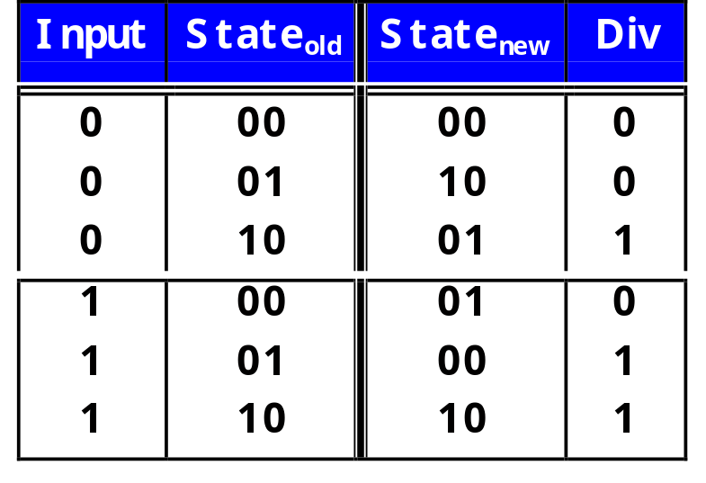
Implementation as Comb logic + Latch
1/0
Alpha/
0
1/1
Beta/
1
0/0
Latch
“Moore Machine”
0/1
Combinational
Logic
0/0
Delta/
2
1/1
“Mealey Machine”
CS252-S07, Lecture 01

Slide 29

Microprogrammed Controllers
State machine in which part of state is a “micro-pc”.
  Explicit circuitry for incrementing or changing PC
Includes a ROM with “microinstructions”.
  Controlled logic implements at least branches and jumps
Instruction
Branch
State w/ Address
Combinational Logic/
Controlled Machine
0: forw 35 xxx
1: b_no_obstacles 000
2: back 10 xxx
3: rotate 90 xxx
4: goto 001
Control
ROM
(Instructions)
Addr
Branch
PC
+ 1
Next Address
MUX
CS252-S07, Lecture 01

Slide 30
Fundamental Execution Cycle
Obtain instruction from program storage
Memory
Instruction
Fetch
Processor
program
Instruction
Decode
Determine required actions and instruction size
regs
Operand
Fetch
Locate and obtain operand data
F.U.s
Data
Execute
Compute result value or status
von Neuman
bottleneck
Result
Store
Deposit results in storage for later use
Next
Instruction
Determine successor instruction
CS252-S07, Lecture 01

Slide 31
What’s a Clock Cycle?
Latch
or
register
combinational
logic
Old days: 10 levels of gates
Today: determined by numerous time-of-flight issues + gate delays
  clock propagation, wire lengths, drivers
CS252-S07, Lecture 01

Slide 32
Pipelined Instruction Execution
Time (clock cycles)
Cycle 1
Cycle 2
Cycle 3
Cycle 4
Cycle 5
Cycle 6
Cycle 7
I
n
s
t
r.
O
r
d
e
r
Ifetch
Reg
ALU
DMem
Reg
Ifetch
Reg
ALU
DMem
Reg
Ifetch
Reg
ALU
DMem
Reg
Ifetch
Reg
ALU
DMem
Reg
CS252-S07, Lecture 01

Slide 33
Limits to pipelining
Maintain the von Neumann “illusion” of one instruction at a time execution
Hazards prevent next instruction from executing during its designated clock cycle
  Structural hazards: attempt to use the same hardware to do two different things at once
  Data hazards: Instruction depends on result of prior instruction still in the pipeline
  Control hazards: Caused by delay between the fetching of instructions and decisions about changes in control flow (branches and jumps).
Power: Too many thing happening at once ⇒ Melt your chip!
  Must disable parts of the system that are not being used
  Clock Gating, Asynchronous Design, Low Voltage Swings, …
CS252-S07, Lecture 01

Slide 34
Progression of ILP
1st generation RISC - pipelined
  Full 32-bit processor fit on a chip => issue almost 1 IPC
    Need to access memory 1+x times per cycle
  Floating-Point unit on another chip
  Cache controller a third, off-chip cache
  1 board per processor ➔ multiprocessor systems
2nd generation: superscalar
  Processor and floating point unit on chip (and some cache)
  Issuing only one instruction per cycle uses at most half
  Fetch multiple instructions, issue couple
    Grows from 2 to 4 to 8 …
  How to manage dependencies among all these instructions?
  Where does the parallelism come from?
VLIW
  Expose some of the ILP to compiler, allow it to schedule instructions to reduce dependences
CS252-S07, Lecture 01

Slide 35
Modern ILP
Dynamically scheduled, out-of-order execution
  Current microprocessor fetch 10s of instructions per cycle
  Pipelines are 10s of cycles deep
  ⇒ many 10s of instructions in execution at once
What happens:
  Grab a bunch of instructions, determine all their dependences, eliminate dep’s wherever possible, throw them all into the execution unit, let each one move forward as its dependences are resolved
  Appears as if executed sequentially
  On a trap or interrupt, capture the state of the machine between instructions perfectly
Huge complexity
  Complexity of many components scales as n² (issue width)
  Power consumption big problem
CS252-S07, Lecture 01

Slide 36
When all else fails - guess
Programs make decisions as they go
  Conditionals, loops, calls
  Translate into branches and jumps (1 of 5 instructions)
How do you determine what instructions for fetch when the ones before it haven’t executed?
  Branch prediction
  Lot’s of clever machine structures to predict future based on history
  Machinery to back out of mis-predictions
Execute all the possible branches
  Likely to hit additional branches, perform stores
  speculative threads
  What can hardware do to make programming (with performance) easier?
CS252-S07, Lecture 01

Slide 37
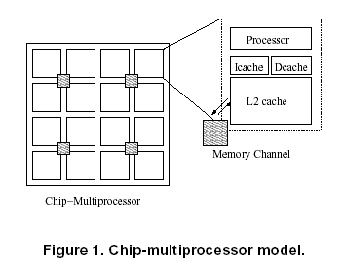
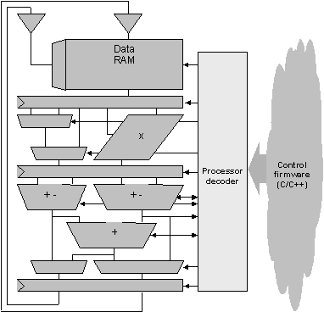
Have we reached the end of ILP?
Multiple processor easily fit on a chip
Every major microprocessor vendor has gone to multithreading
  Thread: loci of control, execution context
  Fetch instructions from multiple threads at once, throw them all into the execution unit
  Intel: hyperthreading, Sun:
  Concept has existed in high performance computing for 20 years (or is it 40? CDC6600)
Vector processing
  Each instruction processes many distinct data
  Ex: MMX
Raise the level of architecture – many processors per chip
Tensilica Configurable Proc
CS252-S07, Lecture 01

Slide 38
The Memory Abstraction
Association of <name, value> pairs
  typically named as byte addresses
  often values aligned on multiples of size
Sequence of Reads and Writes
Write binds a value to an address
Read of addr returns most recently written value bound to that address
command (R/W)
address (name)
data (W)
data (R)
done
CS252-S07, Lecture 01

Slide 39
Processor-DRAM Memory Gap (latency)
1000
µProc
60%/yr.
(2X/1.5yr)
CPU
100
Processor-Memory
Performance Gap:
(grows 50% / year)
Performance
10
DRAM
9%/yr.
(2X/10 yrs)
DRAM
1
1980
1981
1982
1983
1984
1985
1986
1987
1988
1989
1990
1991
1992
1993
1994
1995
1996
1997
1998
1999
2000
Time
CS252-S07, Lecture 01
Notes:
CS252 S05
Y-axis is performance
X-axis is time
Latency
Cliché:
Not e that x86 didn’t have cache on chip until 1989

Slide 40
Levels of the Memory Hierarchy
Capacity
Access Time
Cost
Upper Level
Staging
Xfer Unit
faster
CPU Registers
100s Bytes
<< 1s ns
Registers
Instr. Operands
prog./compiler
1-8 bytes
Cache
10s-100s K Bytes
~1 ns
$1s/ MByte
Cache
Blocks
cache cntl
8-128 bytes
Main Memory
M Bytes
100ns- 300ns
$< 1/ MByte
Memory
Pages
OS
512-4K bytes
Disk
10s G Bytes, 10 ms
(10,000,000 ns)
$0.001/ MByte
Disk
Files
user/operator
Mbytes
Larger
Tape
infinite
sec-min
$0.0014/ MByte
Tape
Lower Level
CS252-S07, Lecture 01
circa 1995 numbers
Notes:
CS252 S05

Slide 41
The Principle of Locality
The Principle of Locality:
  Program access a relatively small portion of the address space at any instant of time.
Two Different Types of Locality:
  Temporal Locality (Locality in Time): If an item is referenced, it will tend to be referenced again soon (e.g., loops, reuse)
  Spatial Locality (Locality in Space): If an item is referenced, items whose addresses are close by tend to be referenced soon
  (e.g., straightline code, array access)
Last 30 years, HW relied on locality for speed
P
$
MEM
CS252-S07, Lecture 01
Notes:
CS252 S05
The principle of locality states that programs access a relatively small portion of the address space at any instant of time.
This is kind of like in real life, we all have a lot of friends. But at any given time most of us can only keep in touch with a small group of them.
There are two different types of locality: Temporal and Spatial. Temporal locality is the locality in time which says if an item is referenced, it will tend to be referenced again soon.
This is like saying if you just talk to one of your friends, it is likely that you will talk to him or her again soon.
This makes sense. For example, if you just have lunch with a friend, you may say, let’s go to the ball game this Sunday. So you will talk to him again soon.
Spatial locality is the locality in space. It says if an item is referenced, items whose addresses are close by tend to be referenced soon.
Once again, using our analogy. We can usually divide our friends into groups. Like friends from high school, friends from work, friends from home.
Let’s say you just talk to one of your friends from high school and she may say something like: “So did you hear so and so just won the lottery.”
You probably will say NO, I better give him a call and find out more.
So this is an example of spatial locality. You just talked to a friend from your high school days. As a result, you end up talking to another high school friend. Or at least in this case, you hope he still remember you are his friend.
+3 = 10 min. (X:50)

Slide 42
The Cache Design Space
Several interacting dimensions
  cache size
  block size
  associativity
  replacement policy
  write-through vs write-back
The optimal choice is a compromise
  depends on access characteristics
    workload
    use (I-cache, D-cache, TLB)
  depends on technology / cost
Simplicity often wins
Cache Size
Associativity
Block Size
Bad
Good
Factor A
Factor B
Less
More
CS252-S07, Lecture 01
Notes:
CS252 S05
No fancy replacement policy is needed for the direct mapped cache.
As a matter of fact, that is what cause direct mapped trouble to begin with: only one place to go in the cache--causes conflict misses.
No fancy replacement policy is needed for the direct mapped cache.
As a matter of fact, that is what cause direct mapped trouble to begin with: only one place to go in the cache--causes conflict misses.
Besides working at Sun, I also teach people how to fly whenever I have time.
Statistic have shown that if a pilot crashed after an engine failure, he or she is more likely to get killed in a multi-engine light airplane than a single engine airplane.
The joke among us flight instructors is that: sure, when the engine quit in a single engine stops, you have one option: sooner or later, you land. Probably sooner.
But in a multi-engine airplane with one engine stops, you have a lot of options. It is the need to make a decision that kills those people.

Slide 43
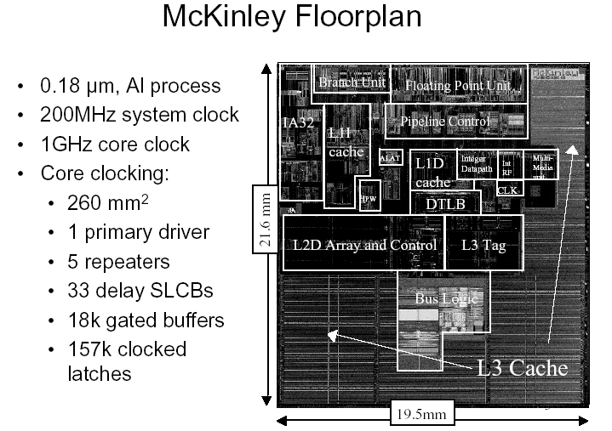
Is it all about memory system design?
Modern microprocessors are almost all cache
CS252-S07, Lecture 01

Slide 44
Memory Abstraction and Parallelism
Maintaining the illusion of sequential access to memory across distributed system
What happens when multiple processors access the same memory at once?
  Do they see a consistent picture?
Processing and processors embedded in the memory?
P
1
P
n
P
1
P
n
$
$
Mem
$
Mem
$
Inter
connection network
Mem
Inter
connection network
Mem
CS252-S07, Lecture 01

Slide 45
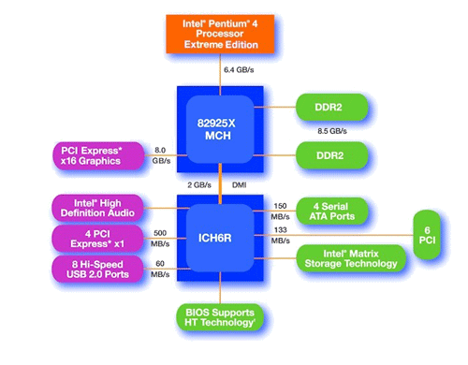
Is it all about communication?
Pentium IV Chipset
Proc
Caches
Busses
adapters
Memory
Controllers
Disks
Displays
Keyboards
I/O Devices:
Networks
CS252-S07, Lecture 01

Slide 46
Breaking the HW/Software Boundary
Moore’s law (more and more trans) is all about volume and regularity
What if you could pour nano-acres of unspecific digital logic “stuff” onto silicon
  Do anything with it. Very regular, large volume
Field Programmable Gate Arrays
  Chip is covered with logic blocks w/ FFs, RAM blocks, and interconnect
  All three are “programmable” by setting configuration bits
  These are huge?
Can each program have its own instruction set?
Do we compile the program entirely into hardware?
CS252-S07, Lecture 01

Slide 47
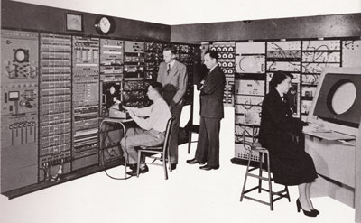
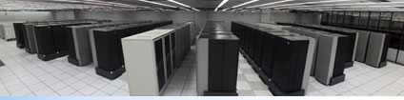
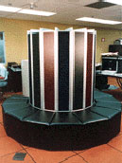
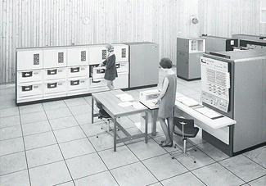
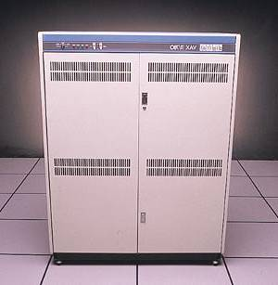
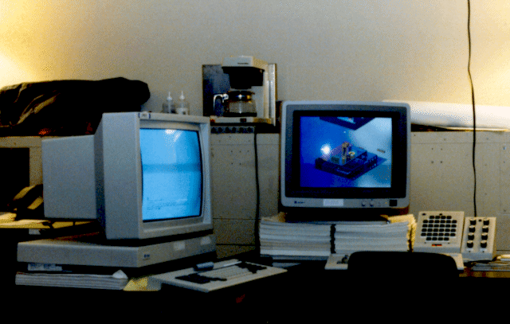

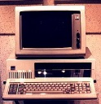



“Bell’s Law” – new class per decade
Number Crunching
Data Storage
log (people per computer)
productivity
interactive
streaming
information
to/from physical
world
Enabled by technological opportunities
Smaller, more numerous and more intimately connected
Brings in a new kind of application
Used in many ways not previously imagined
year
CS252-S07, Lecture 01
Notes:
CS252 S05
So if we look at the computing spectrum today, each of the classes exist simultaneously. In a room we can put 100s of teraflops and many petabytes of computing.
Our productivity, document preparation, and personal information management fits in our pocket and a new class is emerging that will provide a means of streaming information to and from the physical world like we have never seen before.

Slide 48
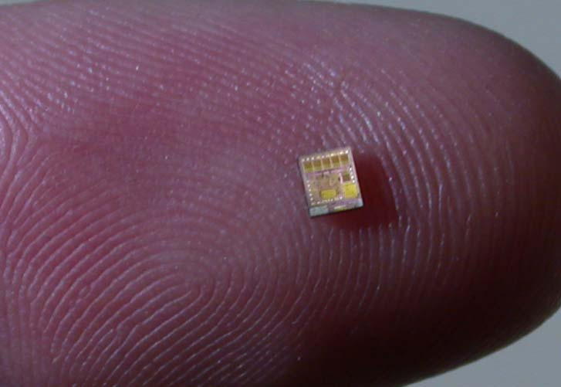
It’s not just about bigger and faster!
Complete computing systems can be tiny and cheap
System on a chip
Resource efficiency
  Real-estate, power, pins, …
CS252-S07, Lecture 01

Slide 49
Crossroads: Conventional Wisdom in Comp. Arch
Old Conventional Wisdom: Power is free, Transistors expensive
New Conventional Wisdom: “Power wall” Power expensive, Xtors free
(Can put more on chip than can afford to turn on)
Old CW: Sufficiently increasing Instruction Level Parallelism via compilers, innovation (Out-of-order, speculation, VLIW, …)
New CW: “ILP wall” law of diminishing returns on more HW for ILP
Old CW: Multiplies are slow, Memory access is fast
New CW: “Memory wall” Memory slow, multiplies fast
(200 clock cycles to DRAM memory, 4 clocks for multiply)
Old CW: Uniprocessor performance 2X / 1.5 yrs
New CW: Power Wall + ILP Wall + Memory Wall = Brick Wall
  Uniprocessor performance now 2X / 5(?) yrs
⇒ Sea change in chip design: multiple “cores”
(2X processors per chip / ~ 2 years)
    More simpler processors are more power efficient
CS252-S07, Lecture 01

Slide 50
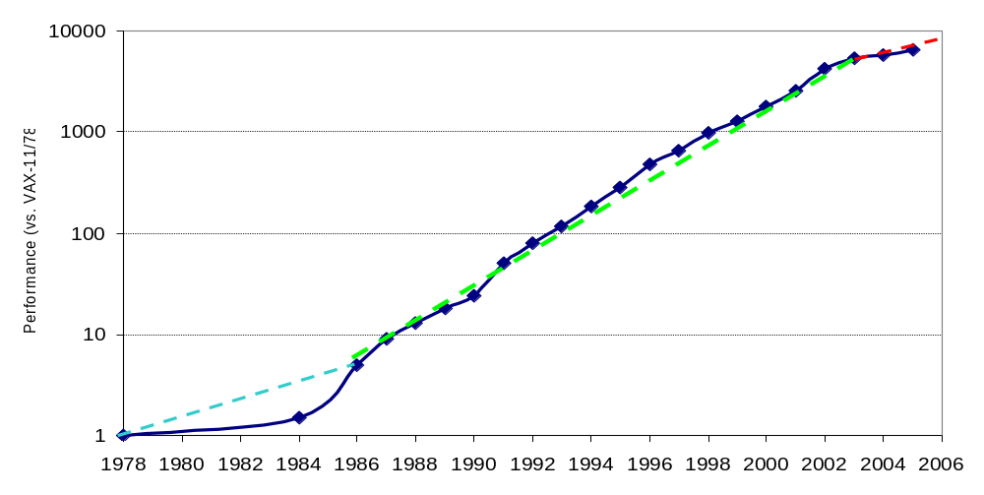
Crossroads: Uniprocessor Performance
From Hennessy and Patterson, Computer Architecture: A Quantitative Approach, 4th edition, October, 2006
VAX : 25%/year 1978 to 1986
RISC + x86: 52%/year 1986 to 2002
RISC + x86: ??%/year 2002 to present
CS252-S07, Lecture 01

Slide 51
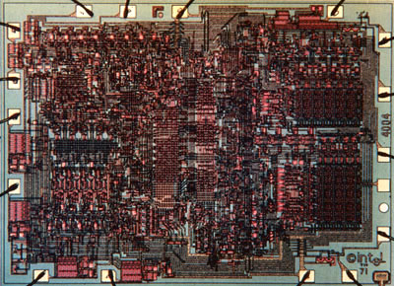
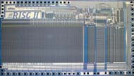
Sea Change in Chip Design
Intel 4004 (1971): 4-bit processor,
2312 transistors, 0.4 MHz,
10 micron PMOS, 11 mm² chip
RISC II (1983): 32-bit, 5 stage
pipeline, 40,760 transistors, 3 MHz,
3 micron NMOS, 60 mm² chip
125 mm² chip, 0.065 micron CMOS
= 2312 RISC II+FPU+Icache+Dcache
  RISC II shrinks to ~ 0.02 mm² at 65 nm
  Caches via DRAM or 1 transistor SRAM (www.t-ram.com) ?
  Proximity Communication via capacitive coupling at > 1 TB/s ?
  (Ivan Sutherland @ Sun / Berkeley)
Processor is the new transistor?
CS252-S07, Lecture 01

Slide 52
Déjà vu all over again?
Multiprocessors imminent in 1970s, ‘80s, ‘90s, …
“… today’s processors … are nearing an impasse as technologies approach the speed of light..”
David Mitchell, The Transputer: The Time Is Now (1989)
Transputer was premature
⇒ Custom multiprocessors strove to lead uniprocessors
⇒ Procrastination rewarded: 2X seq. perf. / 1.5 years
“We are dedicating all of our future product development to multicore designs. … This is a sea change in computing”
Paul Otellini, President, Intel (2004)
Difference is all microprocessor companies switch to multiprocessors (AMD, Intel, IBM, Sun; all new Apples 2 CPUs)
⇒ Procrastination penalized: 2X sequential perf. / 5 yrs
⇒ Biggest programming challenge: 1 to 2 CPUs
CS252-S07, Lecture 01

Slide 53
Problems with Sea Change
Algorithms, Programming Languages, Compilers, Operating Systems, Architectures, Libraries, … not ready to supply Thread Level Parallelism or Data Level Parallelism for 1000 CPUs / chip,
Architectures not ready for 1000 CPUs / chip
  Unlike Instruction Level Parallelism, cannot be solved by just by computer architects and compiler writers alone, but also cannot be solved without participation of computer architects
This edition of CS 252 (and 4th Edition of textbook Computer Architecture: A Quantitative Approach) explores shift from Instruction Level Parallelism to Thread Level Parallelism / Data Level Parallelism
CS252-S07, Lecture 01
Notes:
CS252 S05

Slide 54
Quantifying the
Design Process
CS252-S07, Lecture 01

Slide 55
Focus on the Common Case
Common sense guides computer design
  Since its engineering, common sense is valuable
In making a design trade-off, favor the frequent case over the infrequent case
  E.g., Instruction fetch and decode unit used more frequently than multiplier, so optimize it 1st
  E.g., If database server has 50 disks / processor, storage dependability dominates system dependability, so optimize it 1st
Frequent case is often simpler and can be done faster than the infrequent case
  E.g., overflow is rare when adding 2 numbers, so improve performance by optimizing more common case of no overflow
  May slow down overflow, but overall performance improved by optimizing for the normal case
What is frequent case and how much performance improved by making case faster => Amdahl’s Law
CS252-S07, Lecture 01

Slide 56
Processor performance equation
CPI
inst count
Cycle time
CPU time = Seconds = Instructions x Cycles x Seconds
Program Program Instruction Cycle
Inst Count CPI Clock Rate
Program X
Compiler X (X)
Inst. Set. X X
Organization X X
Technology X
CS252-S07, Lecture 01

Slide 57
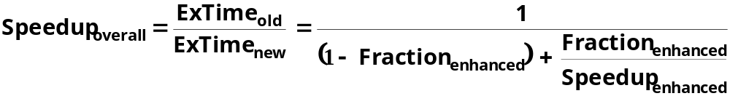
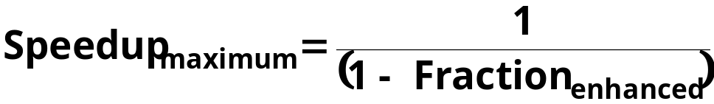
Amdahl’s Law
Best you could ever hope to do:
CS252-S07, Lecture 01

Slide 58
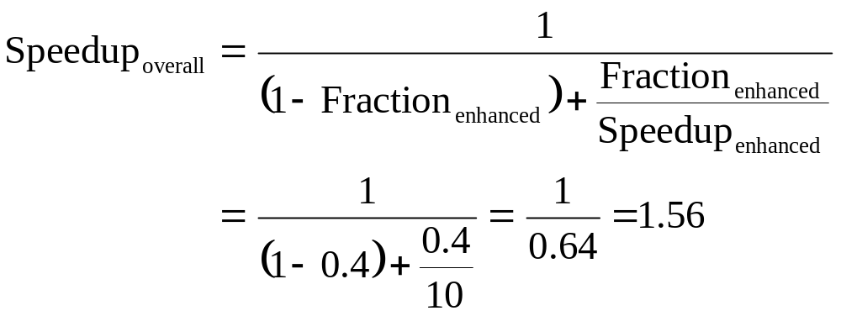
Amdahl’s Law example
New CPU 10X faster
I/O bound server, so 60% time waiting for I/O
Apparently, its human nature to be attracted by 10X faster, vs. keeping in perspective its just 1.6X faster
CS252-S07, Lecture 01

Slide 59
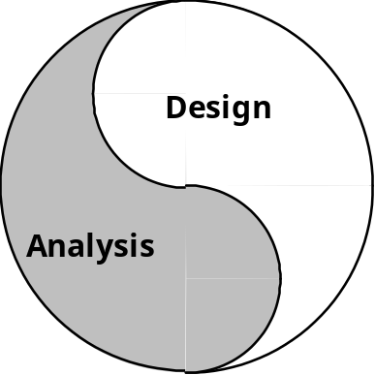
The Process of Design
Architecture is an iterative process:
Searching the space of possible designs
At all levels of computer systems
Creativity
Cost /
Performance
Analysis
Good Ideas
Mediocre Ideas
Bad Ideas
CS252-S07, Lecture 01

Slide 60
And in conclusion …
Computer Architecture >> instruction sets
Computer Architecture skill sets are different
  Quantitative approach to design
  Solid interfaces that really work
  Technology tracking and anticipation
CS 252 to learn new skills, transition to research
Computer Science at the crossroads from sequential to parallel computing
  Salvation requires innovation in many fields, including computer architecture
Read Chapter 1, then Appendix A
  Prereq exam next Wednesday
CS252-S07, Lecture 01

